Slide 1
ETL Pipeline For Keyword Extraction
Course: Advance Database & Systems
Shashank Gupta

Slide 2
Introduction
Why do we need Keywords?
Keywords tell search engines about the content of the websites.
Keywords help understand the mapping pattern between the user search query and relevant content.
Keywords are used as input for various Supervised NLP tasks such as Word Embedding Generation, Text Summarization, and Named Entity Recognition.

Slide 3

Solution
Map user search queries to results and extracts keywords out of them!
Helps understand the search pattern of users
Provides possible keywords to raise SEO content rating
Generates Training Data for NLP-based algorithms

Slide 4
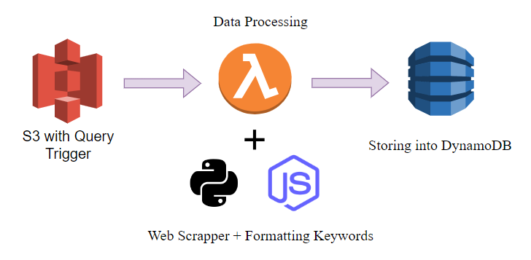
Cloud-based Solution Architecture
User update search query in a CSV into the S3 Bucket
S3 updation triggers Lambda function to run Key Extractor python script, and keywords are extracted.
Script writes the extracted keywords to the DynamoDB database.

Slide 5
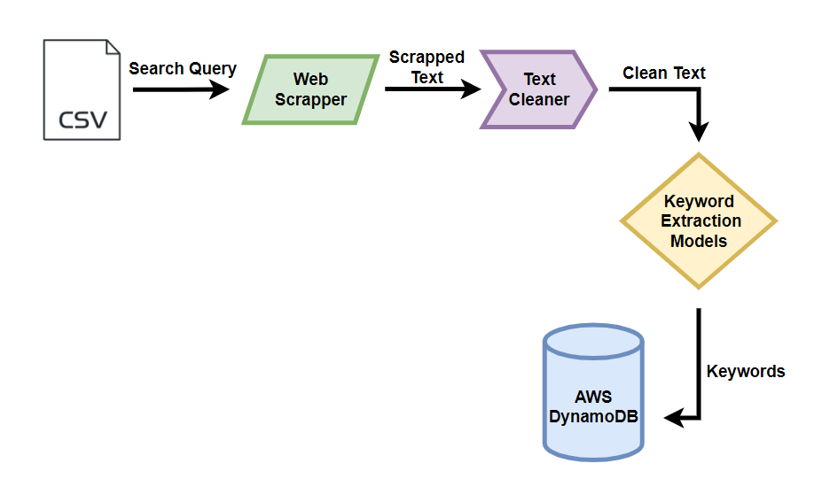
Keyword Extractor Architecture

Slide 6
Text Cleaning & Extraction Models
A. Text Cleaning Operations:
HTML Tags removed
Brackets & Symbols removed
Emails and URLs removed
Applied Lemmatization and removed new line character
B. Available Keyword Extraction Models:
Yake (Average Execution time ~ 20 seconds)
KeyBERT (Average Execution time ~ 40 seconds)
Text-Rank (A Average Execution time ~ 35 seconds)

Slide 7
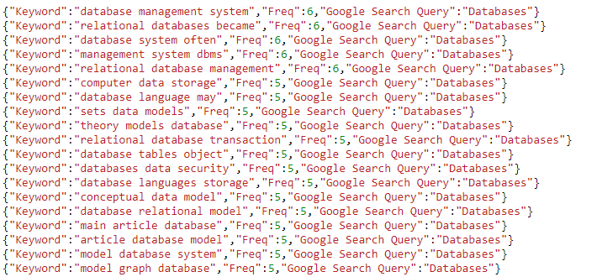
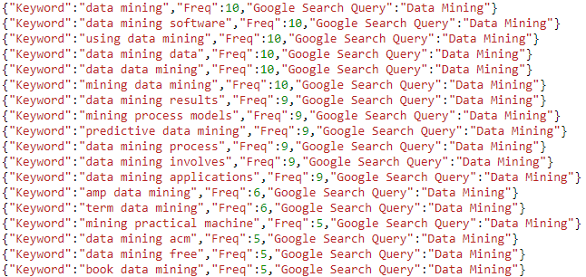
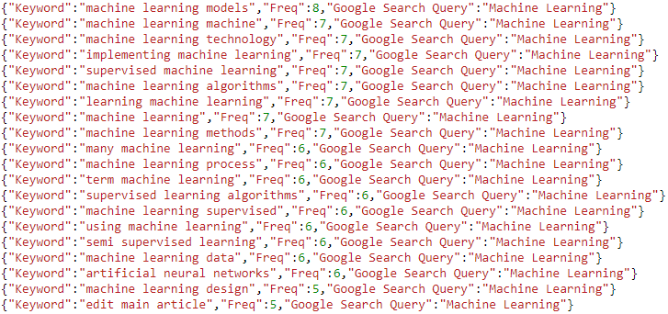
Results
Databases
Data Mining
Machine Learning
Execution Time: 55 sec

Slide 8
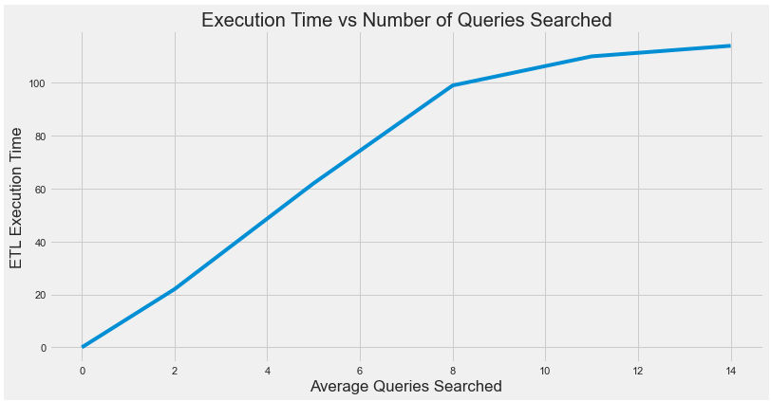
Execution Time Analysis
Execution time is a problem, need to find an optimized solution that scales with the queries searched.
Trend appears to saturate as the number of queries increases.

Slide 9
DEMONSTRATION

